Slide 1

RMD Sinhgad School of Engineering Department of Computer Engineering “Coin Based Mobile Charging”
Presented By: Guide Name:
Swapnil Dhamdere Mrs.Kalpna Saharan
Ajinkya Chawane
Harshada Borkar
Rina Chaudhari
Ganesh Khedkar
Dept. of Computer Engineering, RMDSSOE

Slide 2
CONTENTS
Problem Statement
Motivation
Objectives
Literature Survey
Methodology/ Proposed system block diagram
Software and Hardware requirements
Advantages/Disadvantages of system
Implementation
Challenges Faced
Conclusion and Future Scope
References
Dept. of Computer Engineering, RMDSSOE

Slide 3
Problem Statement
Nowadays mobile phones became integral part of our lives. We are dependable on mobile phones from morning alarm till the ordering dinner. In such modern life when our phone battery is low in emergency & we are out of our homes there no facility in India to provide you to charge your device. So we have decided to design such device which allows you to charge their phones outside their homes by using coins.
Dept. of Computer Engineering, RMDSSOE

Slide 4
Motivation
Firstly, We wanted to do something innovative so we done survey on what we can do which will impact in reality so we focused on mobile charging problem and gonna implement this project on small scale because its costly but it will surely can impact as business idea and also a solution for problem.

Slide 5
Objectives
To reduce wastage of electrical power which often arises due to negligence of user
Provide facility for charging mobile phones at public places.
Creating a smart Technology Environment.
Easily make available the charging station.

Slide 6
Sr. | Year | Paper Title | Author | Abstract | Advantages | Disadvantages
1. | 2020 | A Coin Acceptor - Mobile Battery Charging using Solar Panel | Ammu Anna Mathew, Anoop J R, S. Vivekanandan | A mobile phone charging system based on a coin acceptor system connected with solar panel and battery system is a great service to the public at open places. | More useful to save energy from sun and intelligent tracking solar energy Simple and hand efficient. | High cost, For Implementation it's complex process.
2 | 2018 | Coin Based Cell Phone Charger with Solar Tracking System | Mr. C V Raja Reddy1 , Uzoigwe Daniel2 , Rupesh Rai3 , Balaji R4 | This paper describes coin based cell phone charger using solar tracking system. Mobile phones have become a major source of business. The need to provide a public charging service is essential. | Effectively receive maximum energy from sun towards earth rotation. More useful to save energy from sun and intelligent tracking solar energy Simple and hand efficient. Less expensive. Reduced man power. Low power consumption. | Less effective during winter season. After the energy stored in the battery is finished during night time, it has to wait till the sun rises up for further charging.
3 | 2021 | Mobile Charging Station based on Coin Insertion System | Shaikh Mohd Shakeeb 1, Shaikh Mohd Ahsan 2, Fahad Khan 3, Tanvir Salmani 4, Nayna Dahatonde5 , Junaid Mandviwala 6 | - Mobile phones are marvelous device from past few years for communication as well as for usage in day-today life. Hence, keeping mobile phones charged has become a more significant task. | Less expensive. Reduced man power. Low power consumption. | Constant power supply, Increasing features requires more software related stuff.
Literature Survey

Slide 7
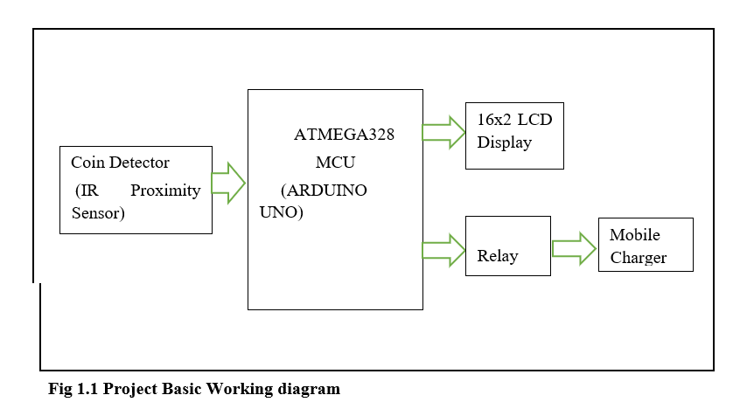
Methodology/ Proposed system block diagram

Slide 8
Software and Hardware requirements
System requirements are the configuration that a system must have in order for a hardware applications to run smoothly and efficiently.
Hardware Requirement :
9V adaptor : 1
5V regural : 1
16x2 LCD : 1
Arduino Uno : 1
IR Sensor : 1
Buzzer : 1
Relay(5V) : 1
Mobile charger adaptor : 1
Bread_board : 1
!2C Connector : 1
Software Requirement :
ARDUINO IDE
EMBDDED CPP CODE

Slide 9
Advantages/Disadvantages of system
Advantages:
Simple and Hand Efficient
Less Expensive
Reduced Man Power
Low Power Consumption
Disadvantages:
Data Breaching
Device Security

Slide 10
Implementation
The smart mobile charger we developed needs to be thought as a full flex product and hence must be seen from a user point of you.
Working of LCD.
Working with IR sensor.
Working of Arduino.
Working of relay.
Working of buzzer for Time Indication.

Slide 11
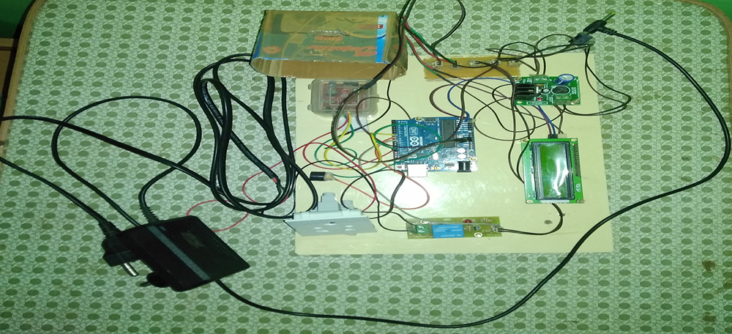
Result

Slide 12
Challenges faced
A technical limitation of a system usually refers to what the define in system is unable to as of its presents state
Project Limitations are as follows:
Safety of Components
AC Power Supply
Different charging ports
High Cost

Slide 13
Conclusion and Future Scope
After overall deployment and testing of our project (including Hardware and Software) thus we have concluded that , we successfully satisfied the expected requirements of the utility of coin base mobile charge.
we have generated the results of a create-and-design research aimed at providing a Coin Based Mobile Charger using Arduino, Coin Sensor and relay.
This plays a vital role in charging the mobile phones. it will be very useful and can be implemented in many areas.
Future Scope :
Use of solar panel as input power supply
Use of coin acceptor to get coin
Use of online payment
Use of GPS module

Slide 14
References
Mr. C V Raja Reddy, Uzoigwe Daniel, Rupesh Rai, Balaji R Coin Based Cell Phone Charger with Solar Tracking System, Mechanical Department, Bangalore Technological Institute, India. 5, 2020
Ammu Anna Mathew, Anoop J R, S. Vivekanandan, A Coin Acceptor - Mobile Battery Charging using Solar Panel. 4, 2020
Shaikh Mohd Shakeeb ¹, Shaikh Mohd Ahsan ², Fahad Khan ³, Tanvir Salmani ⁴, Nayna Dahatonde⁵ , Junaid Mandviwala ⁶ Mobile Charging Station based on Coin Insertion System , 4, 2021
Prachi Bramhe1, Ashwini Sonkusle2, Chandani Baranwal3, Karishma Tekade4, Puja Aware5, Ruchita Jasutkar6, Coin Based Mobile Charger using Solar System, 7, 2019
G.Prityanka, S.Anisha, P.Padma Shri Assistant Professor, Coin Based Mobile Charger, 12, 2018
www.arduino.cc
instructable.com

